Slide 1
Unix Operating Systems
Module 7

Slide 2
Unix Operating System
Versions
Basic Information
User and Group Settings
File Permissions
Local Firewall
Local Security Policies
Permissions and Rights
Tools
Checklist

Slide 3
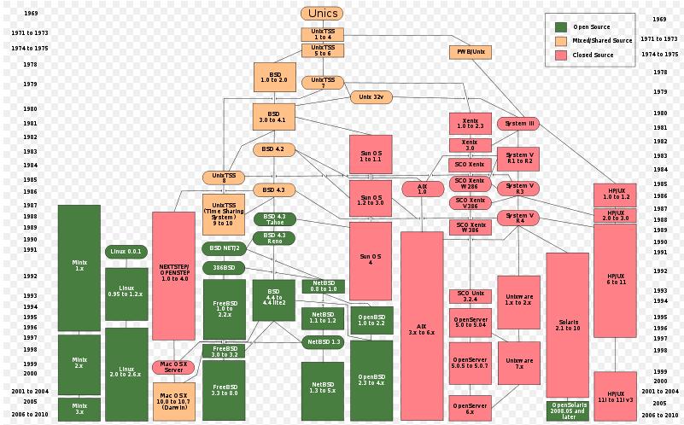
History of Versions

Slide 4

Current Versions
Linux (Red Hat, Fedora, SUSE, Ubuntu)
BSD (OpenBSD, FreeBSD, NetBSD)
Mac OS X
Sun OS
AIX
HP/UX
Solaris
OpenServer
http://www.sitepoint.com/unix-style-operating-systems/

Slide 5


Linux
Different flavors of Linux may be used for the competition like:
  Ubuntu
    http://ubuntuguide.org/wiki/Ubuntu:Oneiric
  Fedora Core
    http://fedoraproject.org/
Many flavors have GUIs for ease of use
Command line interface
  GUIs may not always be available
  For consistency purposes, we will focus on command line rather than GUIs
All flavors built around a “Kernel”
  Main component of the OS
  Made up of CPU, memory, and I/O (Input/Output) devices

Slide 6

Linux 101
Root
  The ‘administrator’ of the system
Password files
  Encrypt passwords
  Located at /etc/passwd and /etc/shadow
System Logs (syslog)
  Configure the Syslog daemon to log messages and events
  Located at the /etc/syslog.conf
Daemon
  A process that runs in the background
Editor
  VI is a text editor used on most Unix operating systems
  Cheat sheet for commands at http://media.smashingmagazine.com/wp-content/uploads/2010/05/VI-Help-Sheet-011.pdf

Slide 7
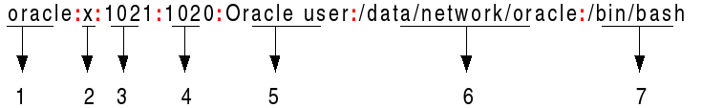
Password Files
Each user has an entry in the password file
1. Username: It is used when user logs in. It should be between 1 and 32 characters in length.
2. Password: An x character indicates that encrypted password is stored in /etc/shadow file.
3. User ID (UID): Each user must be assigned a user ID (UID). UID 0 (zero) is reserved for root and UIDs 1-99 are reserved for other predefined accounts. Further UID 100-999 are reserved by system for administrative and system accounts/groups.
4. Group ID (GID): The primary group ID (stored in /etc/group file)
5. User ID Info: The comment field. It allows you to add extra information about the users such as user's full name, phone number etc. This field is used by the finger command.
6. Home directory: The absolute path to the directory the user will be in when they log in. If this directory does not exists then users directory often becomes /
7. Command/shell: The absolute path of a command or shell (/bin/bash). Typically, this is a shell. Please note that it does not have to be a shell.

Slide 8
Password Files
Passwords are usually not stored in the /etc/passwd file, but rather in the /etc/shadow file
  Passwords are encrypted in the /etc/shadow file
File permissions
  /etc/passwd
    Owned by Root
    Read only to users
  /etc/shadow
    Owned by Root
    Users should not have access to this file
To crack Linux passwords you need the shadow file and sometimes have to merge the passwd and shadow file

Slide 9
User and Group Security
Defaults Users and Groups
  Permissions and privilege tips
    Disable login for well known accounts (bin,sys,uucp)
    Disable all account(s) with no password and lock them down
      passwd -l {user-name}
  Root
    Disable direct login
    Limit number of users with access
    Regularly change password
    For Ubuntu, the root account must be enabled by giving it a password using the sudo command
    Sudo allows an authorized user to temporarily elevate their privileges using their own password instead of having to know the password belonging to the root account
  Locking a user account may not prevent a user access. They may still be able to gain shell access, without the need for any password.

Slide 10

File Permissions
File Type
  Directory – d
  File – ‘-’
File Permissions
  Read - r
  Write (modify) - w
  Execute – x
The first segment defines permissions set for the user, or creator, of the file.
The second segment of three bits defines permissions set for the group that can access the file.
The last segment defines permission for other
Use the chmod command to change user and group permissions
  http://condor.depaul.edu/dpowebpg/support/chmod.html

Slide 11
File System Security
Network File System (NFS) Security
  Method of sharing access to a filesystem between Unix systems
  Only run NFS as needed, apply latest patches (including nfsd, mountd, statd, lockd)
  Careful use of /etc/exports
  Read-only if possible
  No suid if possible
  Fully qualified hostnames
Device Security
  Device files /dev/null, /dev/tty & /dev/console should be world writeable but NEVER executable
  Most other device files should be unreadable and unwriteable by regular users

Slide 12
Services
Disable unnecessary services (daemons)
  If your system is configured with inetd, look at /etc/inetd.conf and prefix a line with a "#" character to make it a comment; then restart the inetd service or reboot
  If you are using xinetd, its configuration will be in the directory /etc/xinetd.d.
    Each file in the directory defines a service, and add disable = yes to any that you want to disable
  Disable daemons not normally used such as
    Telnet
    Anonymous FTP
    Remote processes (Rexec.Rlogin,Rsh)
    Rstatd
    Finger
    Talk, Ntalk

Slide 13
Other Security Tips
Monitor your processes
  Use tools such as Snort, Nessus
  Monitor syslog
Monitor run levels (0 to 6)
  Runlevels define what services or processes should be running on the system
    http://www.unixtools.com/Linux-Runlevels.html
  Make sure all processes are operating on the appropriate runlevel
Encrypt network traffic
  Install ssh
Utilize access control
  Configure hosts.allow and hosts.deny files for tcpd and sshd

Slide 14

Local Security Policies
User profile
  The adduser utility creates a brand new home directory named /home/username
  /etc/default/useradd
  By default, user home directories in Ubuntu are created with world read/execute permissions

Slide 15
Local Security Policies
Password Policy
  Minimum Password Length
    Add the ‘minlen = <x>’ parameter to the pam_unix configuration in the /etc/pam.d/common-password file – Set to 8
      password required pam_cracklib.so retry=3 minlen=8 difok=3
    By default, Ubuntu requires a minimum password length of 4 characters
  Password Expiration
    Needs a minimum and maximum password age forcing users to change their passwords when they expire
      PASS_MIN_DAYS – Set to 7 days
        Minimum number of days allowed between password changes
      PASS_MAX_DAYS – Set from 30 to 90 days
        Maximum number of days a password may be used
      PASS_WARN_AGE – Set to 14 days
        Number of days warning given before a password expires
    Parameters can be set in /etc/login.defs

Slide 16
Local Security Policies
Password History (reuse)
  Create an empty /etc/security/opasswd file for storing old user passwords
  Set permissions to opasswd to the same as the /etc/shawdow file
  Enable password history by adding the “remember=<x>” to the pam_unix configuration in the /etc/pam.d/common-password file
    password required pam_unix.so md5 remember=12 use_authtok
    The value of the "remember" parameter is the number of old passwords to store for a user
  More explanation can be found at
    http://www.deer-run.com/~hal/sysadmin/pam_cracklib.html

Slide 17
Local Security Policies
Account Lockout
  Set to a high enough number that authorized users are not locked out of their user accounts simply because they mistype a password
    Usually set to 5
  Add the following two lines highlighted in blue to the /etc/pam.d/system-auth file
    auth required /lib/security/$ISA/pam_tally.so onerr=fail no_magic_root
    account required /lib/security/$ISA/pam_tally.so per_user deny=5 no_magic_root reset
  The first added line counts failed login and failed su attempts for each user. The default location for attempted accesses is recorded in /var/log/faillog
  The second added line specifies to lock accounts automatically after 5 failed login or su attempts (deny=5)

Slide 18
Local Firewall
Use a local firewall
  UFW (Uncomplicated Firewall)
    Default Ubuntu firewall; but not activated by default
    Command line interface (frontend for iptables)
    Configure and enable
      Set default policies such as drop all connections (deny), then add (allow) rules for specific services
      Enable logging
    https://wiki.ubuntu.com/UncomplicatedFirewall?action=show&redirect=UbuntuFirewall
  Gufw
    Gui for ufw
      Type “sudo apt-get install gufw” at the command line
    Screenshots for Gufw at https://help.ubuntu.com/community/Gufw

Slide 19
Local Firewall
  Firestarter
    Shows active connections and who they belong to
    Controls inbound and outbound traffic
    Displays intrusion attempts as they occur
    Configure firewall to behave in a specific manner for certain types of connections
    Create security policies
    Screenshots can be found at http://www.fs-security.com/screenshots.php
    Download at http://www.fs-security.com/
    Installation directions can be found at http://www.howtogeek.com/howto/ubuntu/install-the-firestarter-firewall-on-ubuntu-linux/

Slide 20
Package Management
Package
  A compressed program or piece of software
Package Managers
  All software on a linux system is divided into RPM packages, which can be installed, upgraded, or uninstalled
  Contain a list of software repositories
  You will be prompted to enter the superuser (root) password before changes are made to the system
RPM Package Manager
  .rpm is the file format for the software package files
  System administrators must manually install with dependencies
  Instead, a front end can be used to automate this process

Slide 21
Package Managers
Common Package Managers (front end)
  YUM – automatic update and package installer
    http://yum.baseurl.org/
  PackageKit (GUI)
    Open Software Updates by clicking Applications → System Tools → Software Update from the Activities menu within the GNOME desktop
  apt-get
    Command line tool
  Aptitude
    Menu driven text based tool (https://help.ubuntu.com/11.04/serverguide/C/aptitude.html)
  Synaptic Package Manager (GUI)
    http://www.nongnu.org/synaptic/

Slide 22
Checklist
Disable unnecessary services
Disable remote login
Disable dangerous features
Employ e-mail security practices
Install and maintain malware protection software
Patch more than just the OS
Research and test updates
Use a desktop/local firewall
Look for alternatives to default applications

Slide 23
List of References
http://www.sans.org/score/checklists/linuxchecklist.pdf
http://oreilly.com/catalog/puis3/chapter/ch11.pdf
http://linu-news.org/?p=1837
http://www.sitepoint.com/unix-style-operating-systems/
https://help.ubuntu.com/8.04/serverguide/C/security.html
http://www.fs-security.com/
https://help.ubuntu.com/community/UFW
http://www.deer-run.com/~hal/sysadmin/pam_cracklib.html
Videos:
  Securing Ubuntu
    http://www.youtube.com/watch?v=H-c1LoVx0WY

